Slide 1

Unit-04.1 Modules
Python Programming(2301CS404)
Prof. Shruti R. Maniar
Computer Engineering Department
shruti.maniar@darshan.ac.in

Slide 2

Outline
Module
Importing a Module
Creating a Custom Module
Random Module
Math Module
Datetime Module
Package
Looping

Slide 3
Module

Slide 4
Module
A Module in Python is a file that contains Python code (functions, classes, variables, etc.) and can be imported into other Python programs as well, to reuse that code.
In simple words a Python module, is a .py file.
All the programs we have written so far have been contained in a single .py file, and so they are modules as well as programs.
The key difference is that programs are designed to be run, whereas modules are designed to be imported and used by programs.
It is not necessary that all modules of Python are written to be in Python only.
Python modules can be written in different programming languages too. (most commonly, C).
For Example: sys and math are implemented in C while os and random modules are pure Python modules.
It makes no difference to our programs what language a module is written in, since all modules are imported and used in the same way.

Slide 5
Importing a Module
import statement is used for importing module and packages.
The last way of importing a module is not recommended, as it can cause conflicts with other functions/variables having the same names of the file in which they are being imported.
Here importable is module, package or a module in a package.
It is common practice to put all the import statements at the beginning of .py files.
Providing alias is particularly useful when experimenting with different implementations of a module.
syntax
syntax
import importable
import importable1, importable2,.., importableN
import importable as preferred_name
from importable import fun1, fun2
from importable import *
import math
import math, os
import math as m
from math import sqrt, pi
from math import *
Not Recommended

Slide 6
Importing a Module (cont.)
For example, We have two modules MyModuleA and MyModuleB having same function fun1().
We can write import MyModuleA as MyModule in a program, and later on seamlessly switch to another module by writing import MyModuleB as MyModule.
MyModuleA.py
1
2
def fun1():
print("This is MyModuleA's function")
MyModuleB.py
1
2
def fun1():
print("This is MyModuleB's function")
Main_file.py
1
2
3
4
import MyModuleA as MyModule
MyModule.fun1() # This will print: This is MyModuleA's function
import MyModuleB as MyModule
MyModule.fun1() # This will print: This is MyModuleB's function

Slide 7
Creating a Custom Module

Slide 8
Creating a Custom Module
To create a custom module, save the file with .py extension.
Now we can use the module we just created, by using the import statement.
Functions of the modules can be called using ModuleName.FunctionName().
MyModule.py
1
2
3
4
# module contain Addition function
def Addition(a,b):
return a+b
Example.py
OUTPUT
1
2
3
4
import MyModule
# function call
print("Add=",MyModule.Addition(3,4))
Add= 7

Slide 9
Variables in Module
The module can contain functions, as already described, but also variables of all types.
We can use them by ModuleName.VariableName in our program.
MyModule.py
1
2
3
4
5
# module contain Addition function
l1 = [1,2,3,4,5,6,7,8,9] def Addition(a,b):
return a+b
Example.py
OUTPUT
1
2
3
4
5
6
import MyModule
# function call
print("Add=",MyModule.Addition(3,4))
# print list data
print("List=", MyModule.l1)
Add= 7
List= [1, 2, 3, 4, 5, 6, 7, 8, 9]

Slide 10
Import from Module
We can choose to import only parts from a module, by using the from keyword.
Sometimes we don't require entire module and we want to use only some of the functions from module.
This can be archived by from keyword with import.
When importing using the from keyword, do not use the module name when referring to elements in the module.
Example.py
MyModule.py
1
2
3
4
from MyModule import l1
# print list data
print("List=", l1)
1
2
3
4
5
# module contain Addition function
l1 = [1,2,3,4,5,6,7,8,9] def Addition(a,b):
return a+b
OUTPUT
List= [1, 2, 3, 4, 5, 6, 7, 8, 9]

Slide 11
Random Module

Slide 12
Random Module
Python has a built-in module that provide set of functions by which we can generate random numbers.
These are pseudo-random numbers means these are not truly random (generated by some algorithm).
random()
This method is used to generate pseudo-random floating point number between 0.0 and 1.0
[ 0 , 1 ) means includes 0, but excludes 1.
syntax
import random
Example.py
OUTPUT
1
2
3
4
import random
print("Random 1=",random.random())
print("Random 2=",random.random())
Random 1= 0.14738964825362189
Random 2= 0.48730431196440027

Slide 13
Random Module (cont.)
seed(a)
A seed is the initial value used by pseudorandom number generator, to start generating a sequence of pseudorandom numbers.
Seed function is used to save the state of a random function.
Saving the state using seed(), will help in generating the same random numbers on multiple executions of the code on the same machine.
Example.py
OUTPUT
1
2
3
4
5
6
7
8
9
import random
random.seed(3) print("Random 1=",random.random())
print("Random 2=",random.random())
random.seed(3) print("Random 3=",random.random())
print("Random 4=",random.random())
Random 1= 0.23796462709189137
Random 2= 0.5442292252959519
Random 3= 0.23796462709189137
Random 4= 0.5442292252959519

Slide 14
Random Module (cont.)
randint(a, b)
This method returns a random integer number within a specified range. Both are inclusive [a, b].
randrange([start], stop, [step])
This method returns a random integer number from the range created by the start, stop and step arguments.
The default value of start is 0 ,and of step is 1. Start is inclusive but stop is exclusive.
Example.py
OUTPUT
1
2
3
4
import random
print("Random 1=",random.randint(1, 100))
print("Random 2=",random.randint(1, 100))
Random 1= 80
Random 2= 39
Example.py
OUTPUT
1
2
3
4
5
import random
#random.ranage(start,stop,step)
print("Random 1=",random.randrange(0, 101,10))
print("Random 2=",random.randrange(0, 11,2))
Random 1= 80
Random 2= 4

Slide 15
Random Module (cont.)
choice(seq)
This method returns a randomly selected element from a non-empty sequence such as list, tuple or string.
shuffle(seq)
This method randomly reorders the elements in a list (mutable sequence).
Example.py
OUTPUT
1
2
3
4
5
6
import random
list1 = [10,232,23,45,34]
t1 = (10,232,23,45,34)
print(random.choice(list1))
print(random.choice(t1))
34
23
Example.py
OUTPUT
1
2
3
4
import random list1 = [10,232,23,45,34]
random.shuffle(list1)
print(list1)
[45, 34, 23, 232, 10]

Slide 16
Random Module (cont.)
uniform(a, b)
This method generates random floating-point number between two given numbers. Both are inclusive.
Example.py
OUTPUT
1
2
3
4
import random
print("Random 1=",random.uniform(2,9))
print("Random 2=",random.uniform(10.23,20.45))
Random 1= 8.079151436715527
Random 2= 15.767192676676762

Slide 17
Math Module

Slide 18
Math Module
This module provides access to some mathematical functions.
This module provides set of methods and constants.
Constants provided by the math module are
Euler’s Number
Pi
Tau
Infinity
Not a Number (NaN) : used to represent undefined or unrepresentable values, such as 0/0.
Example.py
OUTPUT
1
2
3
4
5
6
7
import math
print("e = ", math.e)
print("PI = ", math.pi)
print("Tau = ", math.tau)
print("infinity = ", math.inf)
print("NaN = ", math.nan)
e = 2.718281828459045
PI = 3.141592653589793
Tau = 6.283185307179586
infinity = inf
NaN = nan

Slide 19
Numeric Functions
ceil() and floor()
Ceil value means the smallest integral value greater than the number and the floor value means the greatest integral value smaller than the number.
This can be easily calculated using the ceil() and floor() method respectively.
factorial()
It is used to find factorial of given number.
Example.py
OUTPUT
1
2
3
4
5
import math
n = 5.6
print("Ceil = ",math.ceil(n))
print("Floor = ",math.floor(n))
Ceil = 6
Floor = 5
Example.py
OUTPUT
1
2
3
4
5
import math
n = 5
fact = math.factorial(n)
print("Factorial = ",fact)
Factorial = 120

Slide 20
Numeric Functions(cont.)
gcd()
It is used find greatest common divisor of two number passed as argument.
fabs()
This function returns the absolute value of given number.
Example.py
OUTPUT
1
2
3
4
5
import math
a = 15
b = 30
print("GCD = ",math.gcd(a,b))
GCD = 15
Example.py
OUTPUT
1
2
3
4
import math
n = -15
print("absolute = ",math.fabs(n))
absolute = 15.0

Slide 21
Logarithmic and Power Functions
Function | Description | Example | Output
exp(x) | Returns e raised to the power x | math.exp(1) | 2.718281828459045
pow(x, y) | Returns x raised to the power y : (x**y) | math.pow(5,3) | 125.0
log(x[, base]) | With two arguments, returns the logarithm of x to the given base (default base is : math.e) | math.log(10,2) | 3.3219280948873626
log2(x) | Returns the base - 2 logarithm of x | math.log2(10) | 3.3219280948873626
log10(x) | Returns the base - 10 logarithm of x | math.log10(10) | 1.0
sqrt(x) | Returns the square root of x | math.sqrt(81) | 9.0

Slide 22
Trigonometric and Angular Functions
Function | Description | Example | Output
sin(x) | Returns the sine of x radians. | math.sin(1) | 0.8414709848078965
cos(x) | Returns the cosine of x radians. | math.cos(1) | 0.5403023058681398
tan(x) | Returns the tangent of x radians. | math.tan(1) | 1.557407724654902
degrees() | Converts angle x from radians to degrees. | math.degrees(1.5) | 85.94366926962348
radians() | Converts angle x from degrees to radians. | math.radians(90) | 1.5707963267948966

Slide 23
Special Functions
Function | Description | Example | Output
gamma(x) | Returns the gamma value of x. | math.gamma(6) | 120.0
isinf() | check whether the value is infinity or not. | math.isinf(math.pi) | False
isnan() | check whether the value is NaN or not. | math.isnan(float('nan')) | True
erf(x) | Returns the error function at x. | math.erf(5) | 0.9999999999984626

Slide 24
Datetime Module

Slide 25
Datetime Module
The datetime module supplies classes for manipulating dates and times.
These classes provide a number of functions to deal with dates, times and time intervals.
Date and datetime are object in Python, so when you manipulate them, you are actually manipulating objects and not string or timestamps.
Classes | Description
date | An idealized naive date. Attributes: year, month, and day.
time | An idealized time. Attributes: hour, minute, second, microsecond, and tzinfo.
datetime | A combination of a date and a time. Attributes: year, month, day, hour, minute, second, microsecond, and tzinfo.
timedelta | A duration expressing the difference between two date, time, or datetime instances
tzinfo | An abstract base class for time zone information objects.
timezone | A class that implements the tzinfo abstract base class as a fixed offset from the UTC.

Slide 26
date class
The date class is used to instantiate date objects in Python. When an object of this class is instantiated, it represents a date in the format YYYY-MM-DD.
Constructor of this class needs three mandatory arguments year, month and date.
syntax
Example.py
datetime.date(year, month, day)
1
2
3
4
5
6
import datetime
# print today date
d = datetime.date.today()
print("Date = ",d.day)
print("Month = ",d.month)
print("Year = ",d.year)
Example.py
Example.py
1
2
3
4
import datetime
d = datetime.date(1879,4,14)
print("Birthday=",d)
1
2
3
4
import datetime
# print today date
d = datetime.date.today()
print("Today ",d)
OUTPUT
OUTPUT
OUTPUT
Date = 10
Month = 02
Year = 2025
Birthday 1879-04-14
Today 2025-02-10

Slide 27
time class
The time class creates the time object which represents local time, independent of any day.
syntax
datetime.time(hour, minute, second, microsecond=0, tzinfo=None, *, fold=0)
Example.py
Example.py
1
2
3
4
import datetime
t = datetime.time(10,40,30) print("Time=",t)
1
2
3
4
5
6
7
import datetime
t = datetime.time(10,40,30) print("hour =",t.hour)
print("minute =",t.minute)
print("second =",t.second)
print("microsecond= ",t.microsecond)
OUTPUT
Time= 10:40:30
OUTPUT
hour = 10
minute = 40
second = 30
microsecond = 0

Slide 28
Datetime class
The DateTime class contains information on both date and time.
syntax
datetime.datetime(year, month, day, hour=0, minute=0, second=0, microsecond=0, tzinfo=None, *,fold=0)
Example.py
Example.py
1
2
3
4
5
6
7
8
import datetime a = datetime.datetime(2025, 2, 9, 7, 15, 20)
print("year =", a.year)
print("month =", a.month)
print(“day =", a.day)
print("hour =", a.hour)
print("minute =", a.minute)
print("timestamp =", a.timestamp())
1
2
3
4
import datetime
today = datetime.datetime.now()
print("Current ", today)
OUTPUT
Current 2025-02-10 08:10:42.397856
OUTPUT
year = 2025
month = 02
day = 09
hour = 07
minute = 15
timestamp = 944980932.0

Slide 29
Timedelta class
Python timedelta class is used for calculating differences in dates and also can be used for date manipulations in Python. It is initialized using keyword arguments like days, seconds, etc.
syntax
datetime.timedelta(days=0, seconds=0, microseconds=0, milliseconds=0, minutes=0, hours=0, weeks=0)
Example.py
Example.py
1
2
3
4
5
6
import datetime
today = datetime.datetime.now()
df2 = today + datetime.timedelta(days=2)
print("Current ", today)
print("After 2 days ", df2)
1
2
3
4
5
6
7
8
import datetime
today = datetime.datetime.now()
df2 = today + datetime.timedelta(days=2)
td = df2 - today
print("Current : ", today)
print("After 2 days : ", df2)
print("difference : ", td)
OUTPUT
Current : 2025-02-03 23:22:24.550069
After 2 days : 2025-02-05 23:22:24.550069
OUTPUT
Current : 2025-02-03 23:22:24.550069
After 2 days : 2025-02-05 23:22:24.550069
difference : 2 days, 0:00:00

Slide 30
Format Datetime
strftime()and strptime() method converts the given date, time or datetime object to a string representation of the given format or vice versa.
Example.py
OUTPUT
1
2
3
4
5
6
7
8
9
10
11
12
13
14
15
import datetime
my_string = str(input('Enter date(yyyy-mm-dd): '))
date1 = datetime.datetime.strptime(my_string, "%Y-%m-%d")
today = datetime.datetime.now()
s = date1.strftime("%A %m %Y")
print('Example 1:', s)
s = today.strftime("%a %m %y")
print('Example 2:', s)
s = today.strftime("%I %p %S")
print('Example 3:', s)
s = today.strftime("%H:%M:%S")
print('Example 4:', s)
Enter date(yyyy-mm-dd): 1995-3-2
Example 1: Thursday 03 1995
Example 2: Fri 12 21
Example 3: 11 PM 38
Example 4: 23:38:38

Slide 31
Package

Slide 32
Package
A Package is a folder/directory that contains modules and a file named as __init__.py.
Package will have __init__.py file, whereas normal folders will not have that file.
This means that every directory inside of the Python path, which contains a file named __init__.py, will be treated as a package by Python.
A package can contain one or more relevant modules.
my_project/
│── main.py
│── my_package/
│ ├── __init__.py
│ ├── module1.py
│ ├── module2.py
Package : my_package

Slide 33
Creating Custom Package
First, we create a directory and give it a package name, preferably related to its operation.
Then we create a module, put the classes and the required functions in it.
Finally we create an __init__.py file inside the directory, to let Python know that the directory is a package.
MyModule.py
1
2
3
4
5
# module contain Addition function
l1 = [1,2,3,4,5,6,7,8,9] def Addition(a,b):
return a+b
Package1
__init_.py
Example.py
1
2
3
4
import Package1.MyModule
# print list data
print("List=", Package1.MyModule.l1)
MyModule.py
OUTPUT
List= [1, 2, 3, 4, 5, 6, 7, 8, 9]

Slide 34
Unit-04.2 Matplotlib
Python Programming(2301CS404)
Prof. Shruti R. Maniar
Computer Engineering Department
shruti.maniar@darshan.ac.in

Slide 35

Outline
Introduction to Matplotlib
Graph
Plot
Drawing Multiple Lines and Plots
Export graphs/plots to Image/PDF/SVG
Axis, Ticks ad Grids
Line Appearance
Labels, Annotation, Legends
Types of Graphs
Pie Chart
Bar Chart
Histogram
Boxplot
Scatterplot
Looping

Slide 36
Introduction to Matplotlib
Information can be visualized better, if it is given in graphical format rather in the text format.
Graphics help people observe relationships and make comparisons with greater ease.
Python makes the task of converting textual data into graphics relatively easy using some libraries.
One of the most commonly used library for Data Visualization is, Matplotlib.
Matplotlib is a comprehensive library for creating static, animated, and interactive visualizations in Python.

Slide 37



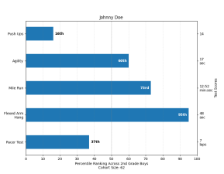
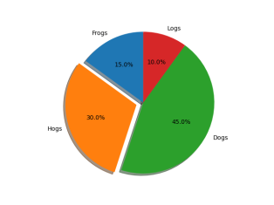
Graph
A Graph or chart is simply a visual representation of numeric data.
Matplotlib makes a large number of graphs and charts.
We can choose any of the common graphs such as Line Chart, Histogram, Scatter Plot, Bar Chart, Pie Chart, etc.
Line Chart
Histogram
Scatter Plot
Bar Chart
Pie Chart

Slide 38
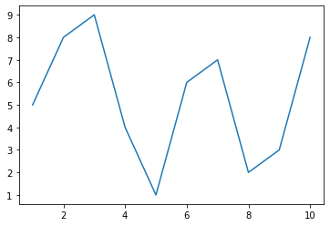
Plot
To define a plot, we need some values, the matplotlib.pyplot module and an idea of what we want to display.
In this case, the code tells the plt.plot() function to create a plot using x-axis from 1 and 10 and y-axis as per y list.
plotDemo1.py
1
2
3
4
5
import matplotlib.pyplot as plt
y = [5,8,9,4,1,6,7,2,3,8]
x = list(range(1,11)
plt.plot(x, y)
plt.show()

Slide 39
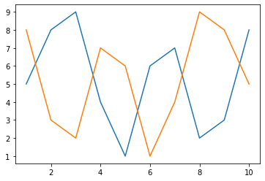
Plot – Drawing multiple lines
We can draw multiple lines in a plot by making multiple plt.plot() calls.
plotDemo1.py
1
2
3
4
5
6
import matplotlib.pyplot as plt
values1 = [5,8,9,4,1,6,7,2,3,8]
values2 = [8,3,2,7,6,1,4,9,8,5] plt.plot(range(1,11),values1)
plt.plot(range(1,11),values2)
plt.show()

Slide 40
Plot – Export graphs/plots
We can export/save our plots on a drive using savefig() method.
Possible values for the format parameters are
png
svg
pdf
jpg
jpeg, etc...
plotDemo1.py
1
2
3
4
5
6
7
import matplotlib.pyplot as plt
values1 = [5,8,9,4,1,6,7,2,3,8]
values2 = [8,3,2,7,6,1,4,9,8,5]
plt.plot(range(1,11),values1)
plt.plot(range(1,11),values2)
#plt.show()
plt.savefig('SaveToPath.png',format='png')
SaveToPath.png

Slide 41
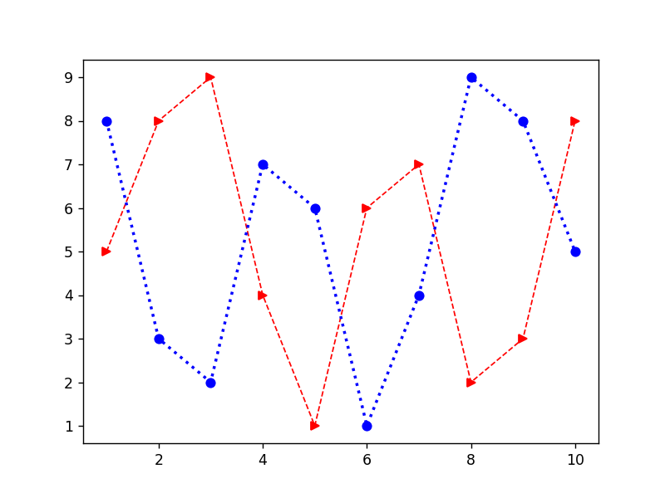
Plot – Line Appearance
We need different line styles in order to differentiate when having multiple lines in the same plot, we can achieve this using many parameters, some of them are listed below.
Line style (linestyle or ls)
Line width (linewidth or lw)
Line color (color or c)
Markers (marker)
plotDemo1.py
1
2
3
4
5
6
import matplotlib.pyplot as plt
values1 = [5,8,9,4,1,6,7,2,3,8]
values2 = [8,3,2,7,6,1,4,9,8,5] plt.plot(range(1,11),values1,c='r',lw=1,ls='--',marker='>')
plt.plot(range(1,11),values2,c='b',lw=2,ls=':',marker='o')
plt.show()

Slide 42
Plot – Line Appearance (Cont.)
Possible Values for each parameters are,
Values | Line Style
‘-’ | Solid line
‘--’ | Dashed line
‘-.’ | Dash-dot line
‘:’ | Dotted line
Values | Color
‘b’ | Blue
‘g’ | Green
‘r’ | Red
‘c’ | Cyan
‘m’ | Magenta
‘y’ | Yellow
‘k’ | Black
‘w’ | White
Values | Marker
‘.’ | Point
‘,’ | Pixel
‘o’ | Circle
‘v’ | Triangle down
‘^’ | Triangle up
‘>’ | Triangle right
‘<’ | Triangle left
‘*’ | Star
‘+’ | Plus
‘x’ | X
Etc.......

Slide 43
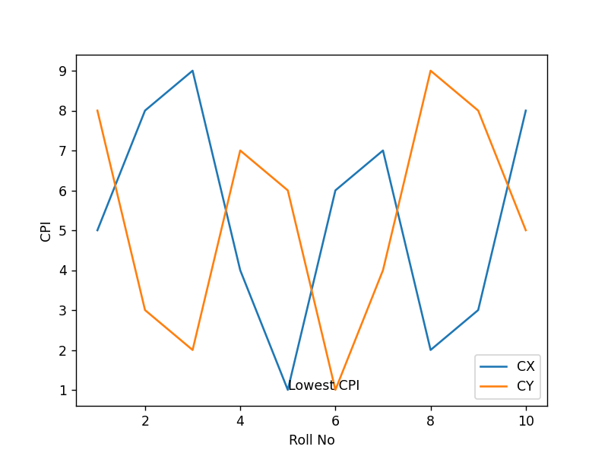
Plot – Labels, Annotation and Legends
To fully document our graph, we have to resort the labels, annotation and legends.
Each of this elements has a different purpose as follows,
Label : provides identification of a particular data element or grouping, it will make easy for viewer to know the name or kind of data illustrated.
Annotation : augments the information the viewer can immediately see about the data with notes, sources or other useful information.
Legend : presents a listing of the data groups within the graph and often provides clues ( such as line type or color) to identify the line with the data.
Y Label
Annotation
Legend
X Label

Slide 44
Plot – Labels, Annotation and Legends (Example)
plotDemo1.py
1
2
3
4
5
6
7
8
9
10
import matplotlib.pyplot as plt
values1 = [5,8,9,4,1,6,7,2,3,8]
values2 = [8,3,2,7,6,1,4,9,8,5]
plt.plot(range(1,11),values1)
plt.plot(range(1,11),values2)
plt.xlabel('Roll No')
plt.ylabel('CPI')
plt.annotate('Lowest CPI’, xy=[5,1])
plt.legend(['CX','CY'],loc=4)
plt.show()

Slide 45
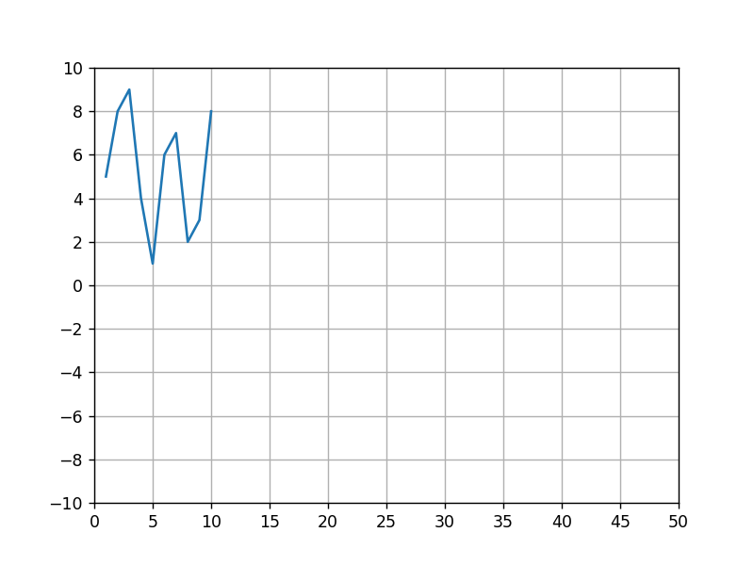
Plot – Axis, Ticks and Grid
We can access and format the axis, ticks and grid on the plot using the axes() method of the matplotlib.pyplot.
plotDemo1.py
1
2
3
4
5
6
7
8
9
10
import matplotlib.pyplot as plt
values = [5,8,9,4,1,6,7,2,3,8]
ax = plt.axes()
ax.set_xlim([0,50])
ax.set_ylim([-10,10])
ax.set_xticks([0,5,10,15,20,25,30,35,40,45,50])
ax.set_yticks([-10,-8,-6,-4,-2,0,2,4,6,8,10])
ax.grid()
plt.plot(range(1,11),values)
plt.show()

Slide 46
Choosing the Right Graph
The kind of graph we choose determines how people view the associated data, so choosing the right graph from the outset is important.
For example,
If we want to display trends over time, we should use line chart.
if we want to show how various data elements contribute towards a whole, we should use pie chart.
If we want to compare data elements, we should use bar chart.
If we want to find patterns in data, we should use scatterplots.
If we want to show distribution of elements, we should use histograms.
If we want to depict groups in elements, we should use boxplots.
All the above graphs are there in our syllabus and we are going to cover all the graphs in this Unit.

Slide 47
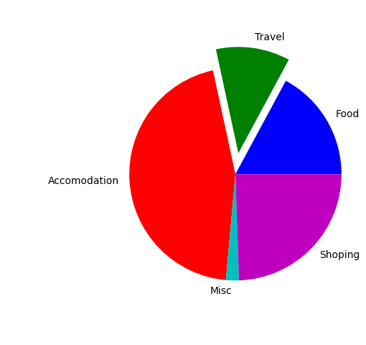
Pie Chart
Pie chart focus on showing parts of a whole, the entire pie would be 100 percentage, the question is how much of that percentage each value occupies.
pieChartDemo.py
1
2
3
4
5
6
7
import matplotlib.pyplot as plt
values = [305,201,805,35,436]
l =['Food','Travel','Accomodation','Mis','Shopping']
c = ['b','g','r','c','m']
e = [0,0.2,0,0,0]
plt.pie(values,colors=c,labels=l,explode=e)
plt.show()

Slide 48
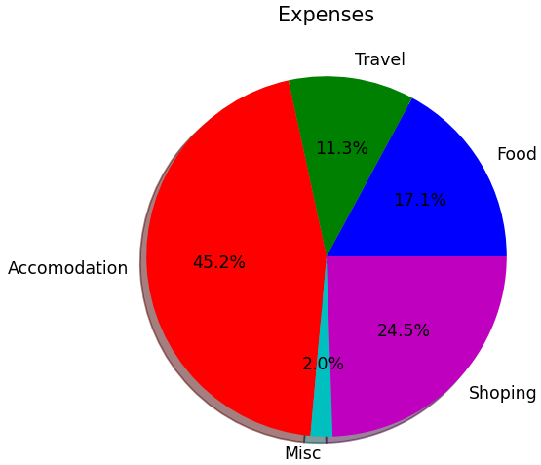
Pie Chart (Cont.)
There are lots of other options available with the pie chart, we are going to cover two important parameters in this slide.
pieChartDemo.py
1
2
3
4
5
6
7
import matplotlib.pyplot as plt
values = [305,201,805,35,436]
l=['Food','Travel','Accomodation','Misc','Shoping']
c = ['b','g','r','c','m']
plt.pie(values,colors=c,labels=l,shadow=True,
autopct='%1.1f%%’)
plt.title('Expenses')
plt.show()

Slide 49
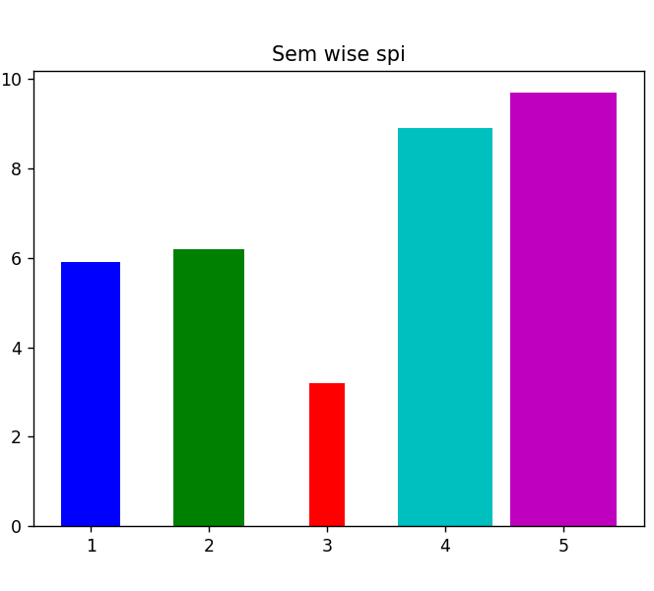
Bar chart
Bar chart makes comparing values easy, wide bars and segregated measurements emphasize the difference between values, rather that the flow of one value to another as a line graph.
Note: you can use barh() function to generate horizontal bar chart.
barChartDemo.py
1
2
3
4
5
6
7
8
9
import matplotlib.pyplot as plt
x = [1,2,3,4,5]
y = [5.9,6.2,3.2,8.9,9.7]
l = ['1st','2nd','3rd','4th','5th']
c = ['b','g','r','c','m']
w = [0.5,0.6,0.3,0.8,0.9]
plt.title('Sem wise spi')
plt.bar(x,y,color=c,label=l,width=w)
plt.show()

Slide 50
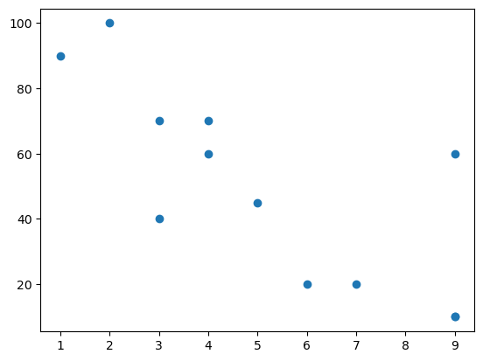
Scatter Plot
A scatter plot is a type of plot that shows the data as a collection of points.
The position of a point depends on its two-dimensional value, where each value is a position on either the horizontal or vertical dimension.
It is really useful to study the relationship/pattern between variables.
now, Consider one terminal which records the speed of the cars.
ScatterPlotDemo.py
1
2
3
4
5
import matplotlib.pyplot as plt carAge = [2,5,7,9,4,3,1,9,4,3,6,9]
carspeed =[100,45,20,10,60,70,90,60,70,40,20,10] plt.scatter(carAge, carspeed)
plt.show()

Slide 51
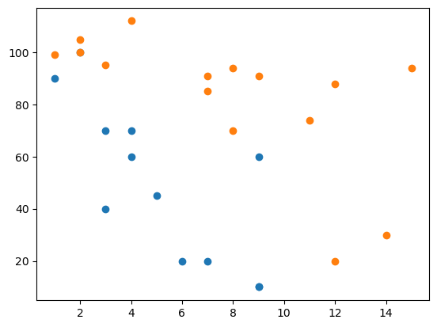
Scatter Plot
Now take days wise observations.
ScatterPlotDemo.py
1
2
3
4
5
6
7
8
9
import matplotlib.pyplot as plt # day -1
carAge = [2,5,7,9,4,3,1,9,4,3,6,9]
carspeed = [100,45,20,10,60,70,90,60,70,40,20,10] # day -2
carAge1 = [2,2,8,1,15,8,12,9,7,3,11,4,7,14,12]
carspeed1 = [100,105,70,99,94,94,88,91,91,95,74,112,85,30,20] plt.scatter(carAge, carspeed)
plt.scatter(carAge1, carspeed1)
plt.show()

Slide 52
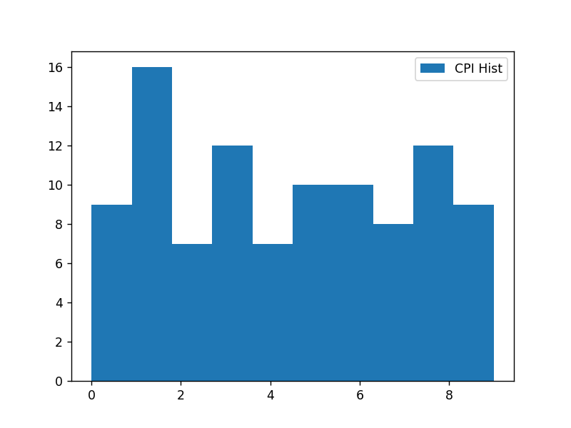
Histogram
Histogram categorizes data by breaking it into bins, where each bin contains a subset of the data range.
A Histogram then displays the number of items in each bin so that you can see the distribution of data and the progression of data from bin to bin.
histDemo.py
1
2
3
4
5
6
7
import matplotlib.pyplot as plt
import random
%matplotlib notebook
cpis = [random.randint(0,10) for _ in range(100)]
plt.hist(cpis,bins=10,histtype='stepfilled',align='mid',label='CPI Hist')
plt.legend()
plt.show()
%matplotlib notebook is used to enable interactive Matplotlib plot.
It allows you to zoom, pan, and update the figure dynamically within the interface.

Slide 53
Boxplot
Boxplots provide a means of depicting groups of numbers through their quartiles.
Quartiles means three points dividing a group into four equal parts.
In boxplot, data will be divided in 4 part using the 3 points (25th percentile, median, 75th percentile)
Interquartile Range
(IQR)
Outliers
Whiskers
Whiskers
Outliers
Minimum
(Q1 – 1.5 * IQR)
Maximum
(Q3 + 1.5 * IQR)
Median
Q1
(25th Percentile)
Q2
(50th Percentile)
Q3
(75th Percentile)
-5
-4
-3
-2
-1
0
1
2
3
4
5

Slide 54
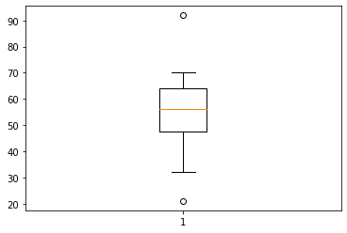
Boxplot (Cont.)
Boxplot basically used to detect outliers in the data, lets see an example where we need boxplot.
We have a dataset where we have time taken to check the paper, and we want to find the faculty which either takes more time or very little time to check the paper.
We can specify other parameters like
widths, which specify the width of the box
notch, default is False
vert, set to 0 if you want to have horizontal graph
boxDemo.py
1
2
3
import matplotlib.pyplot as plt
plt.boxplot([50,45,52,63,70,21,56,68,54,57,35,62,65,92,32])
plt.show()

